Slide 1
Nintendo: An In-Depth Analysis
Dustin Na

Slide 2
Overview
In recent years, Nintendo has been able to compete with Sony with their superiority in handheld consoles and intellectual property. In fact, with the release of the Wii Nintendo was able to properly compete against Sony in the Console Gaming market. However, the WiiU has been underperforming and has failed to achieve the success that the Wii enjoyed. What can Nintendo do at this point to reposition themselves against Sony?

Slide 3
Agenda
What is the geographic distribution and sales breakdown per product?
How do Nintendo products compare to PlayStation products?
Of the segment which proves most attractive, which titles are responsible for driving the highest profit?
Of the current products that Nintendo produces, does there exist any consoles or genres that they should divest themselves of?
Where should Nintendo focus their resources?

Slide 4
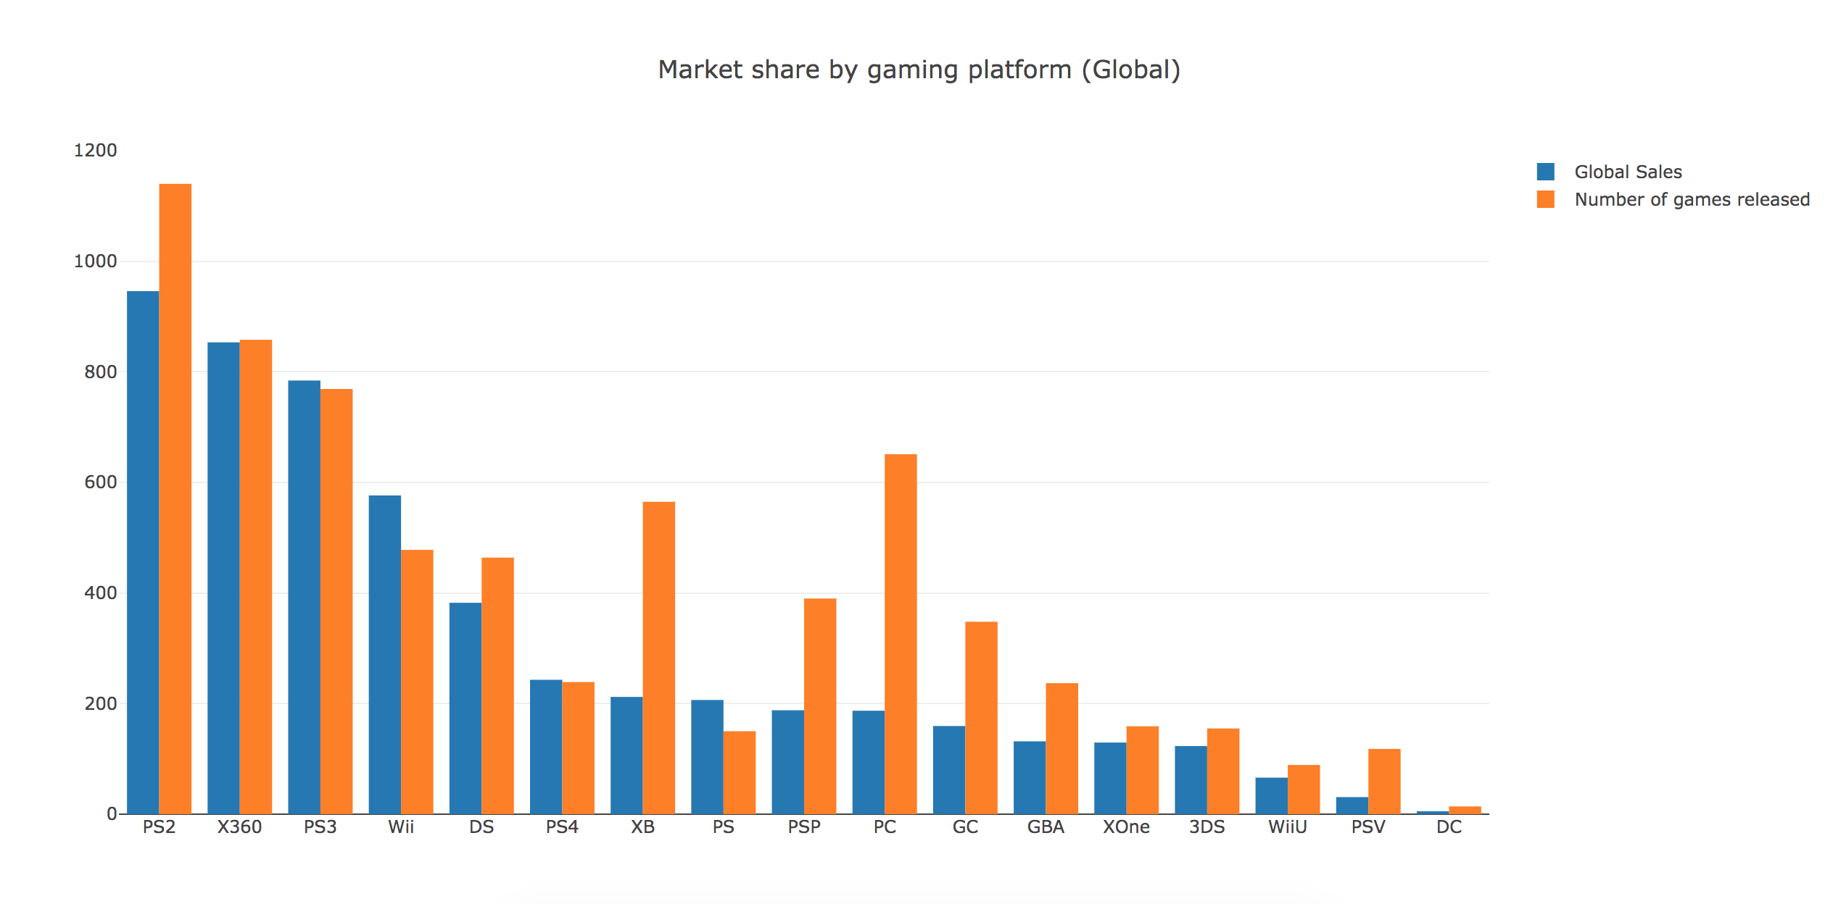
The majority of video game sales are attributed to PlayStation and Xbox, with Nintendo coming up from behind

Slide 5
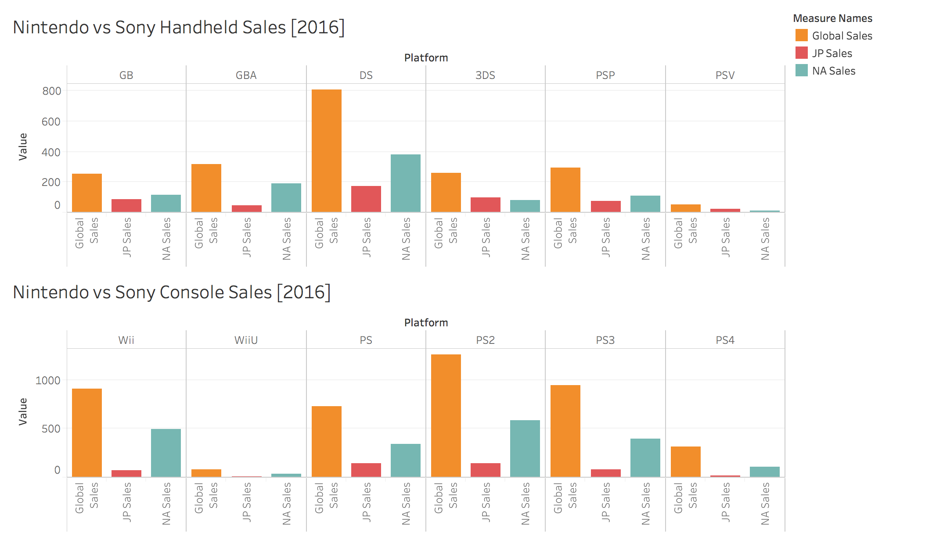
Nintendo has the advantage when it comes to handheld consoles, but is losing out when it comes to gaming consoles

Slide 6
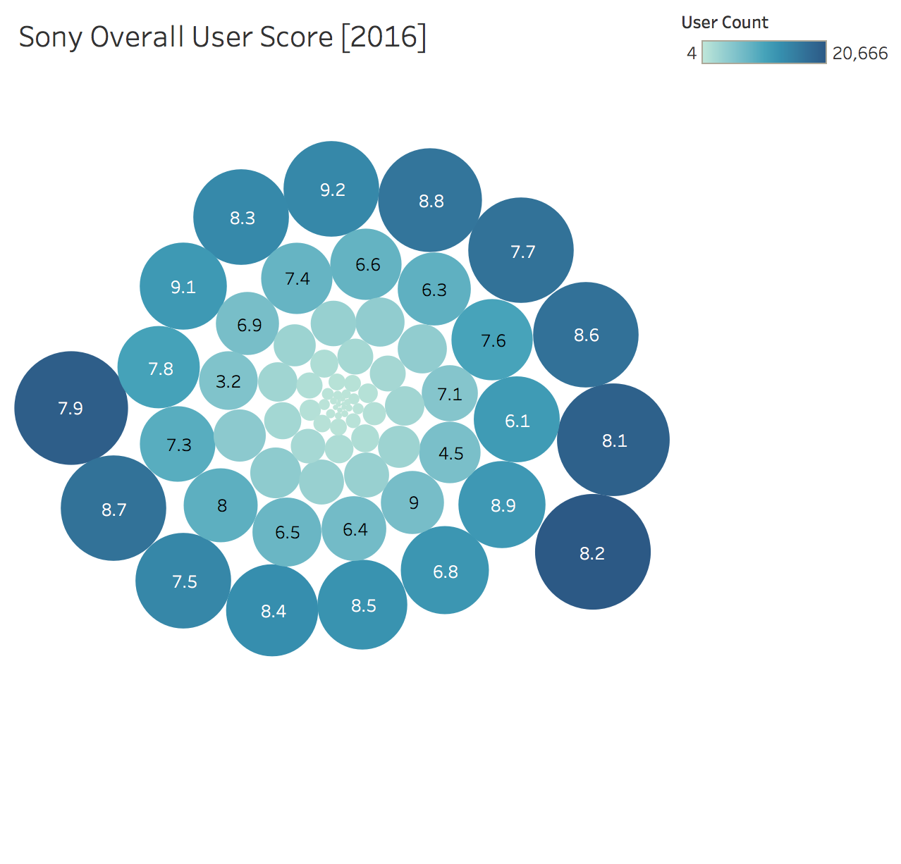
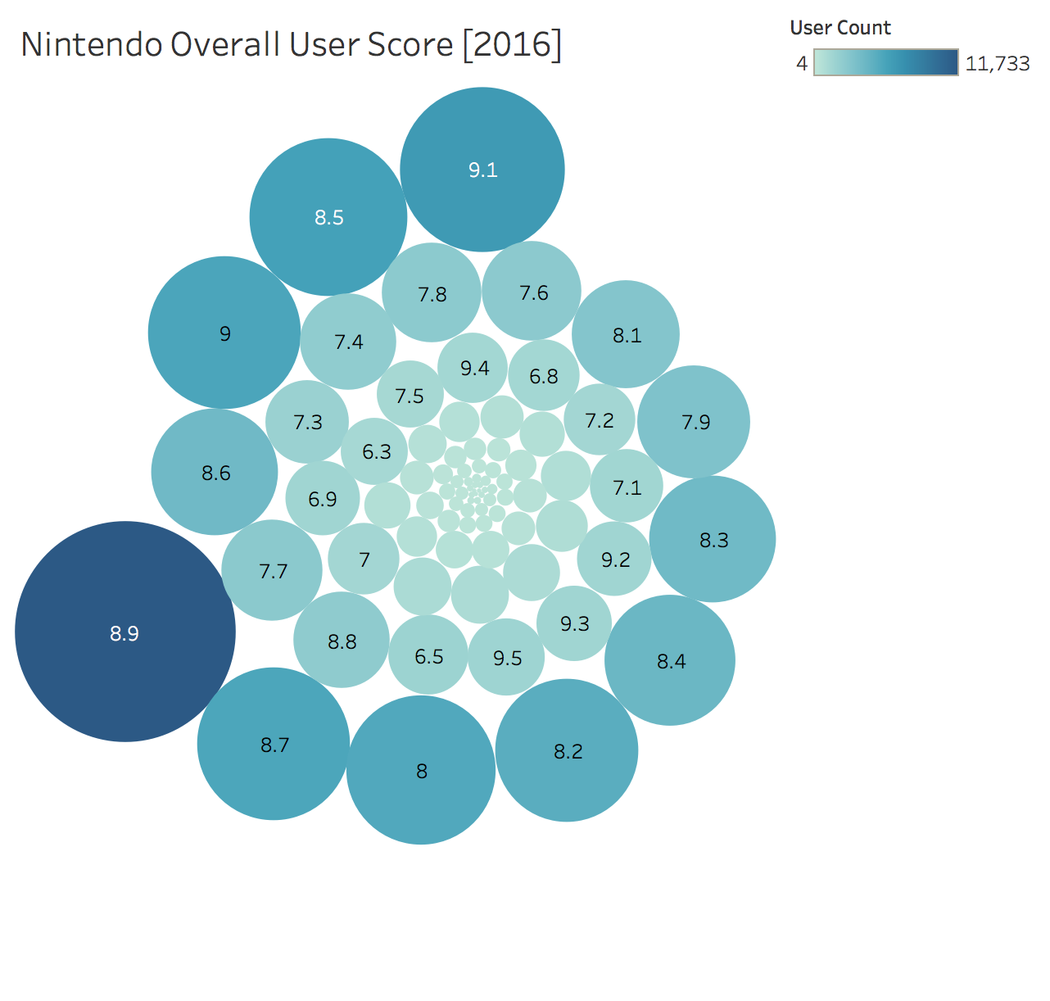
Nintendo vs Sony: Popularity

Slide 7
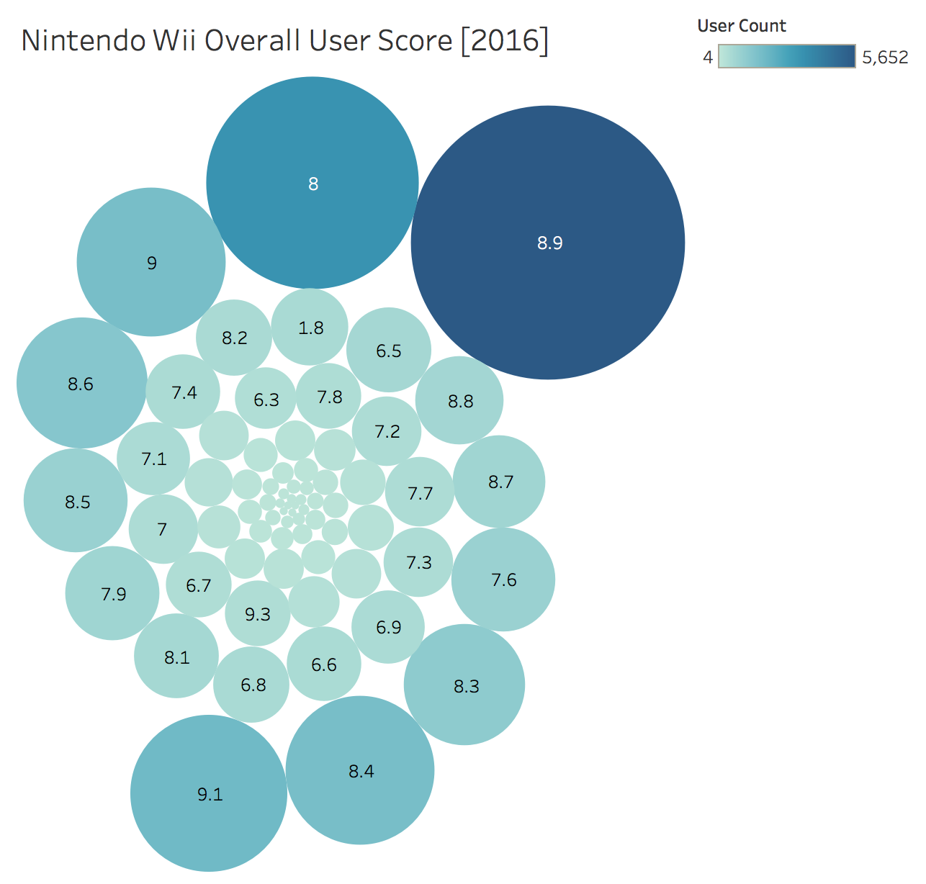
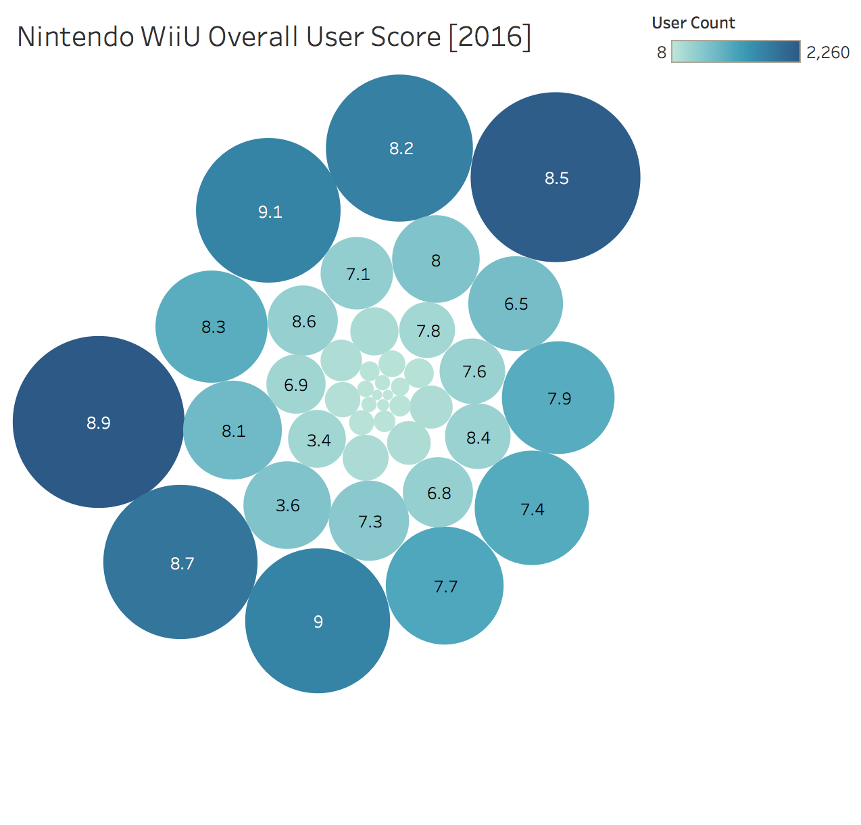
While Nintendo Products are well received, more than half of the users who used a Wii did not purchase a WiiU

Slide 8
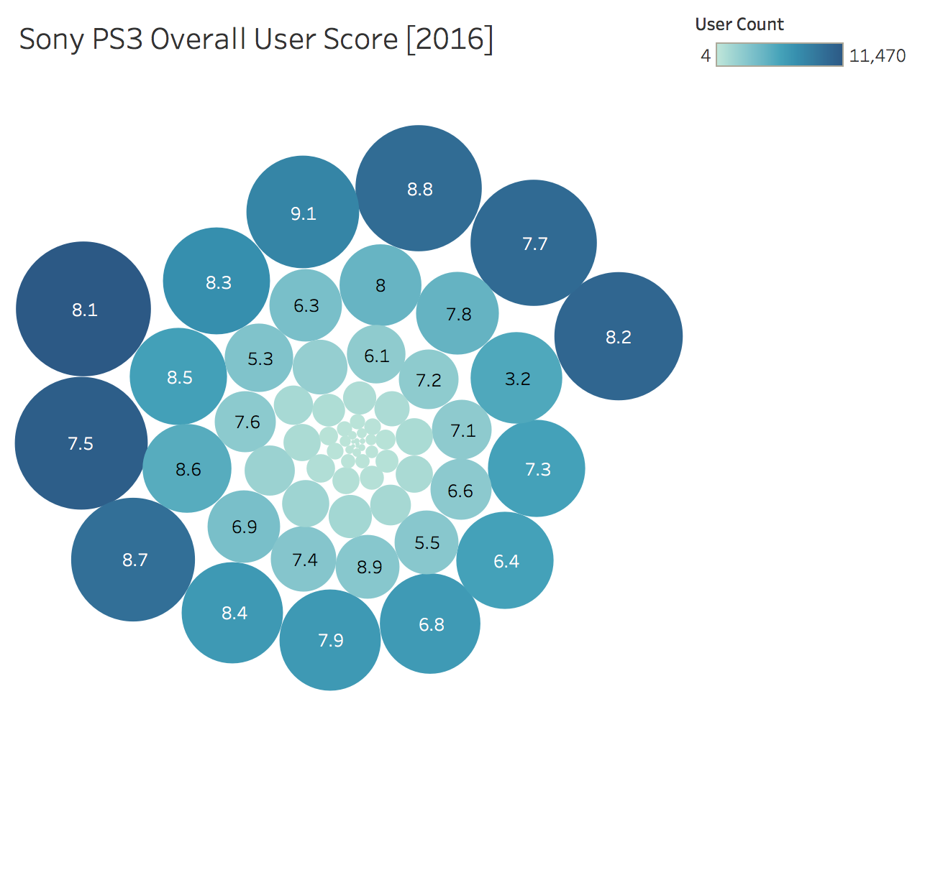
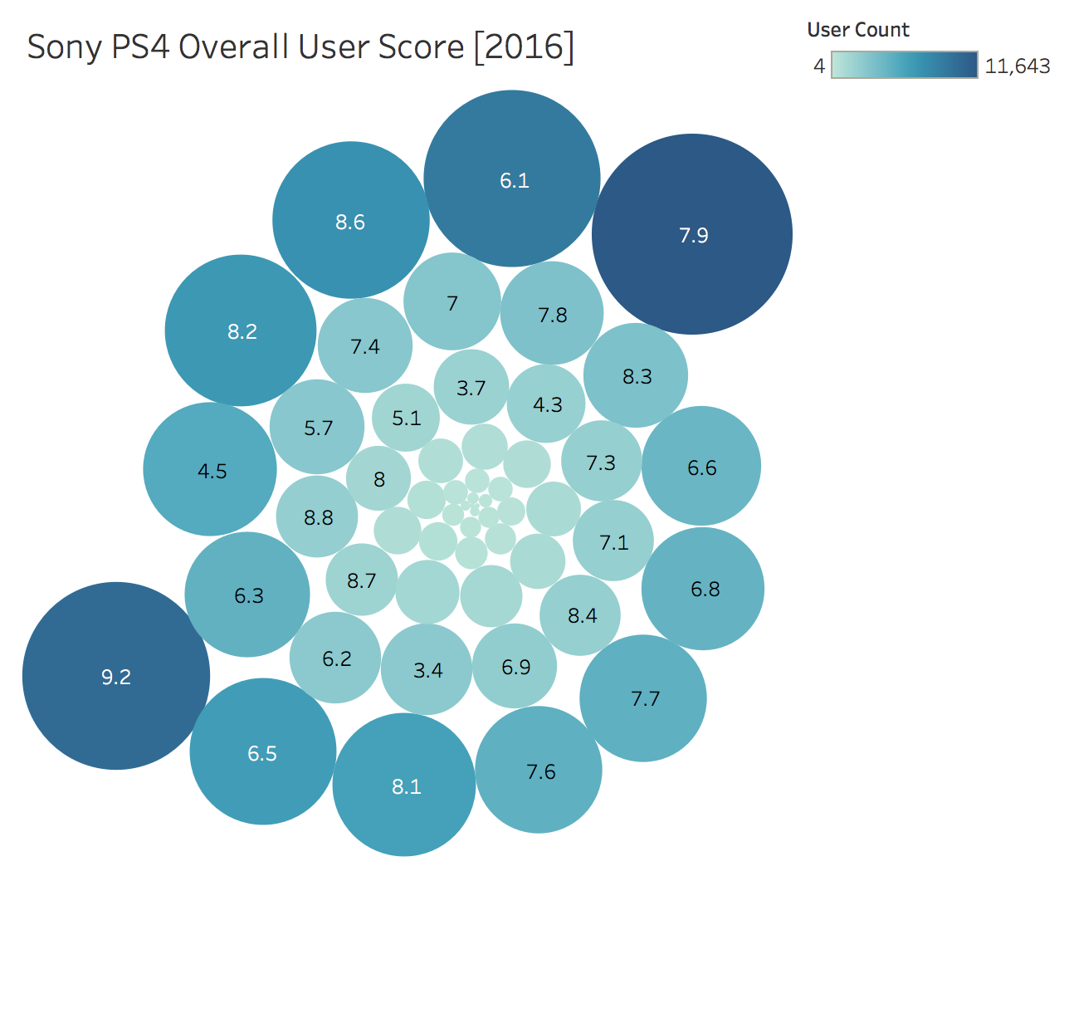
Compared to Nintendo, PlayStation has more variation in User Score but is more stable in User Retention

Slide 9
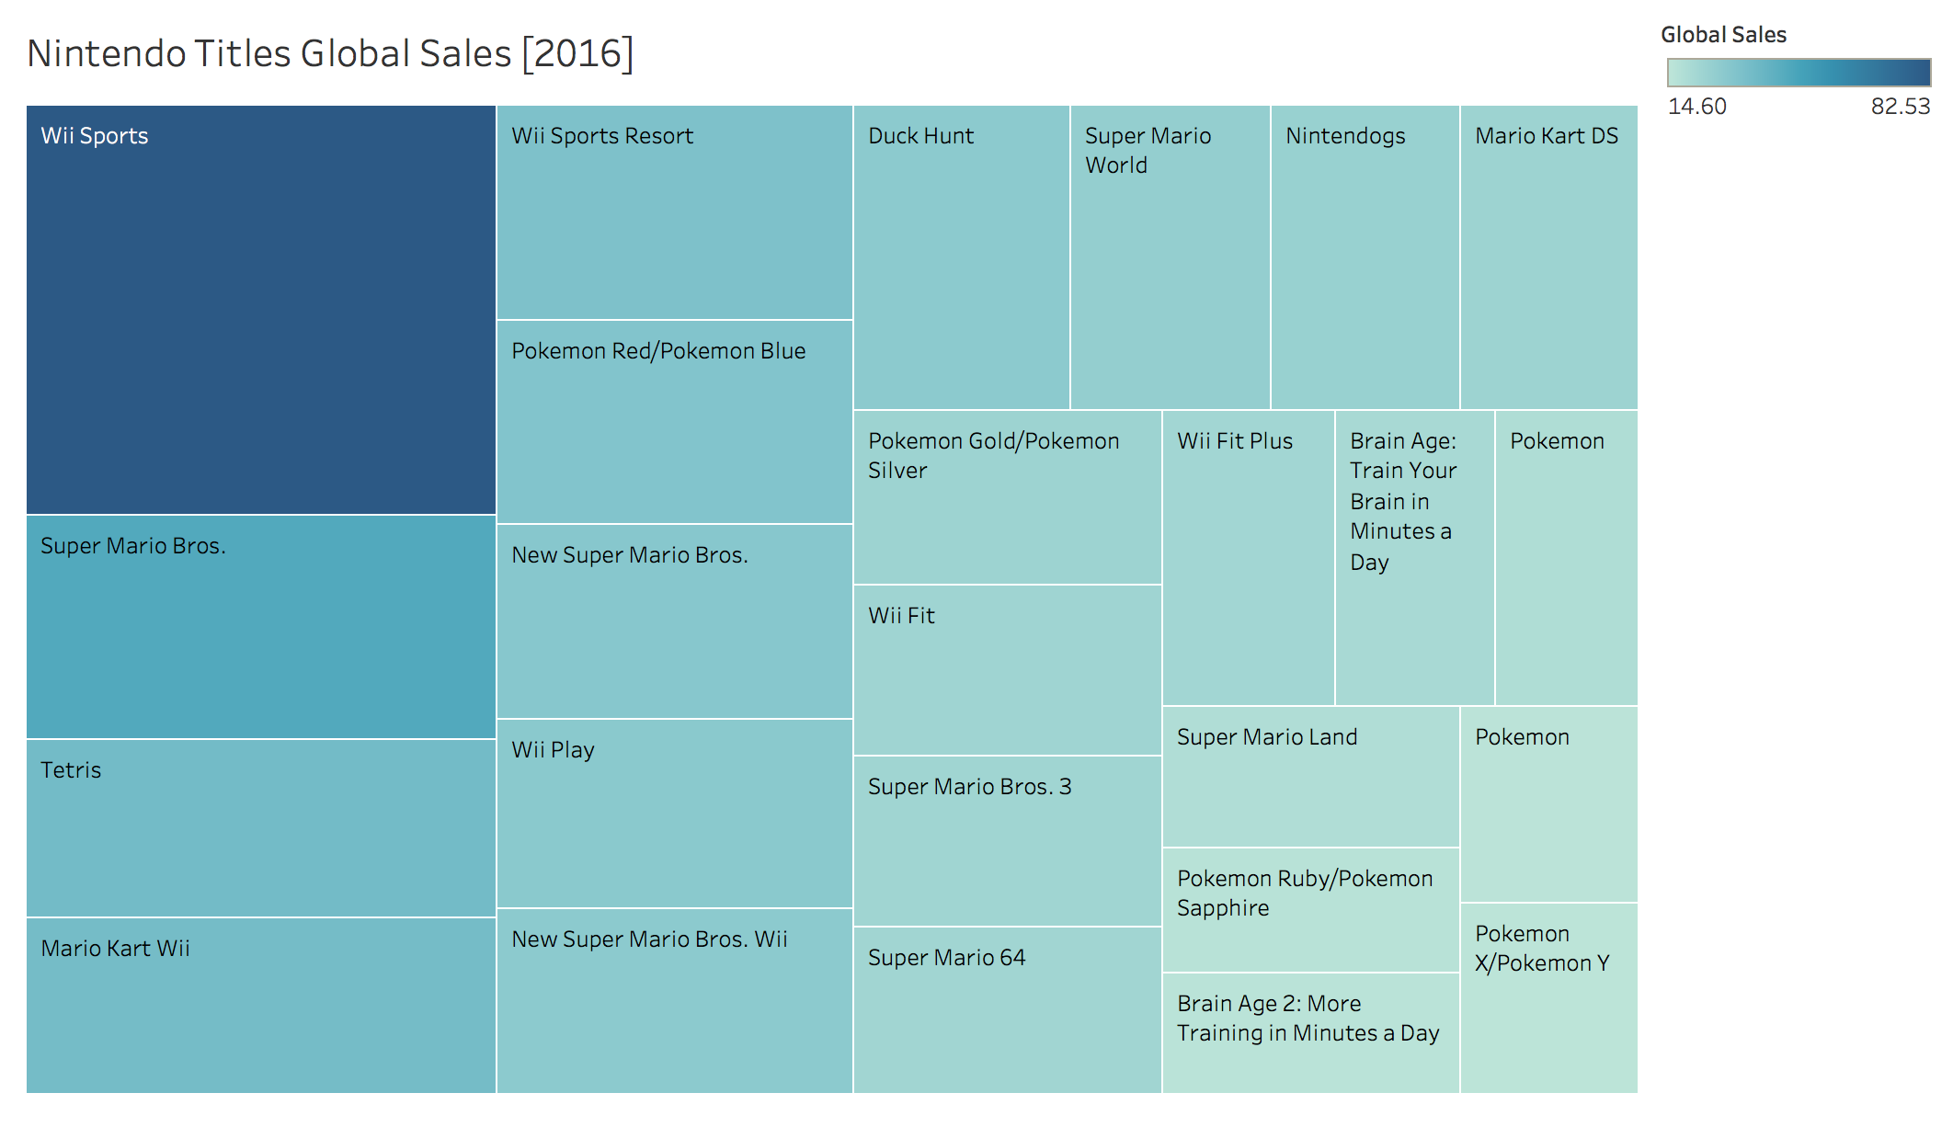
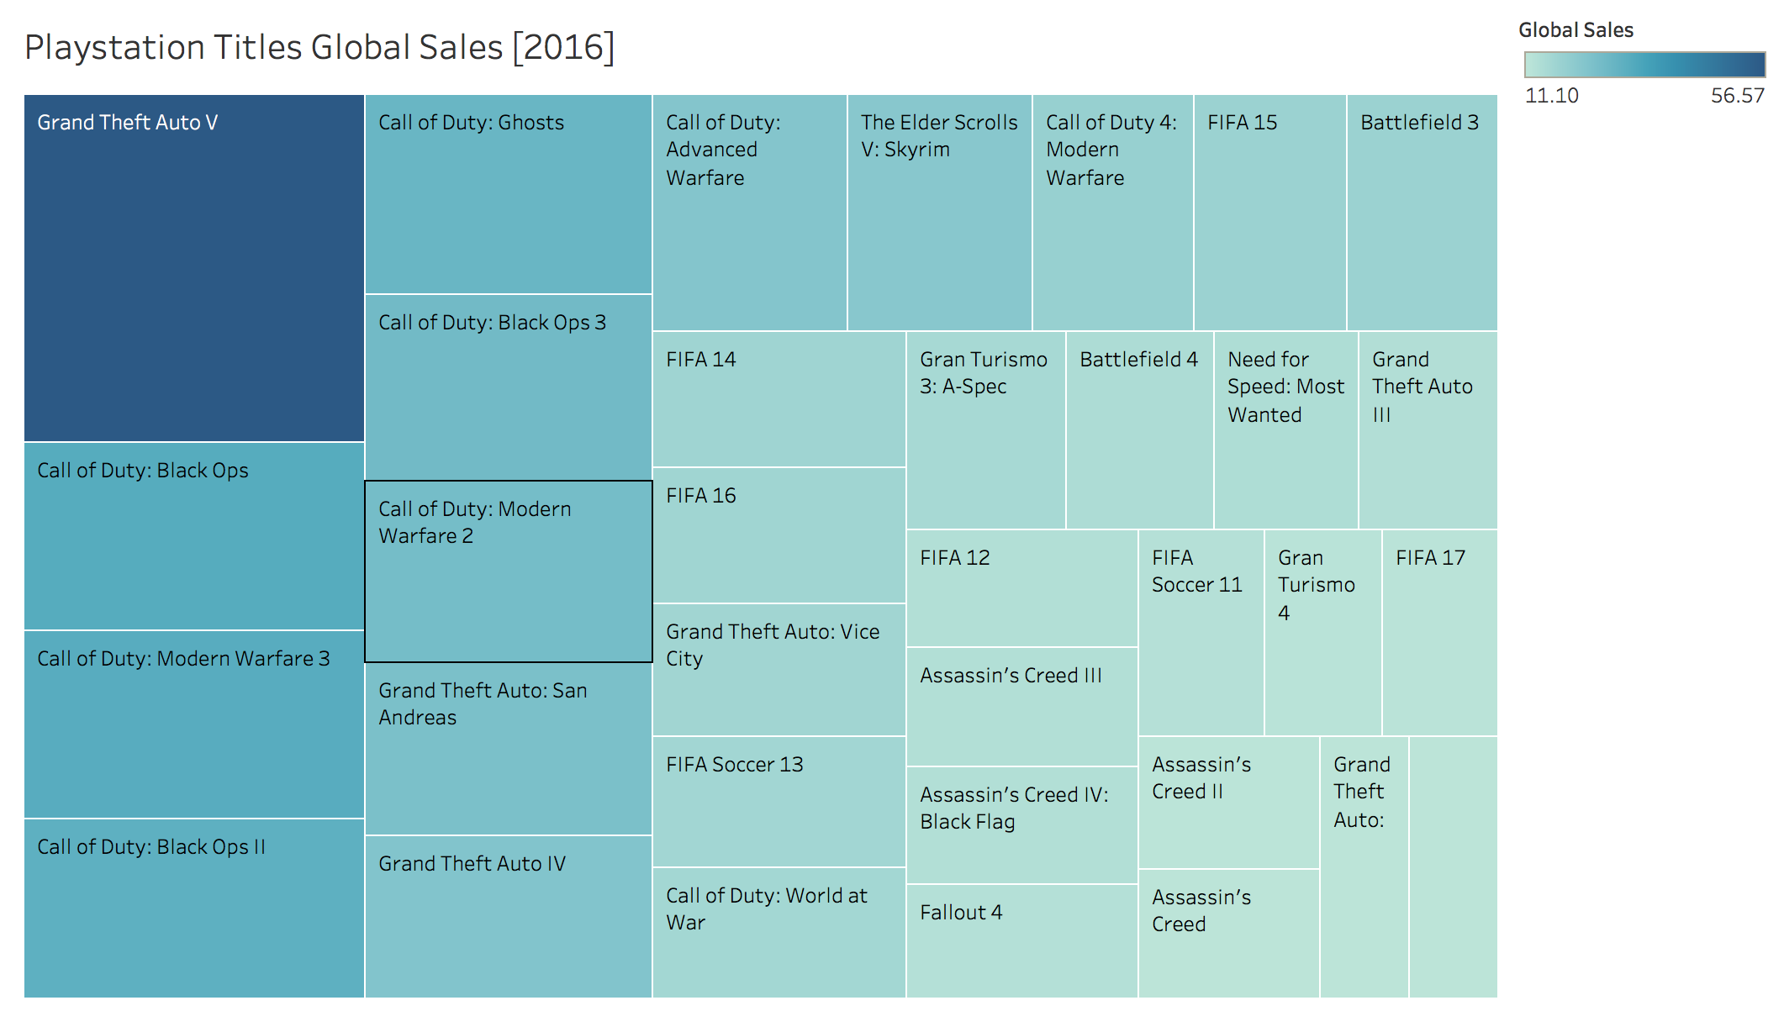
Nintendo vs PlayStation: Title Diversity

Slide 10
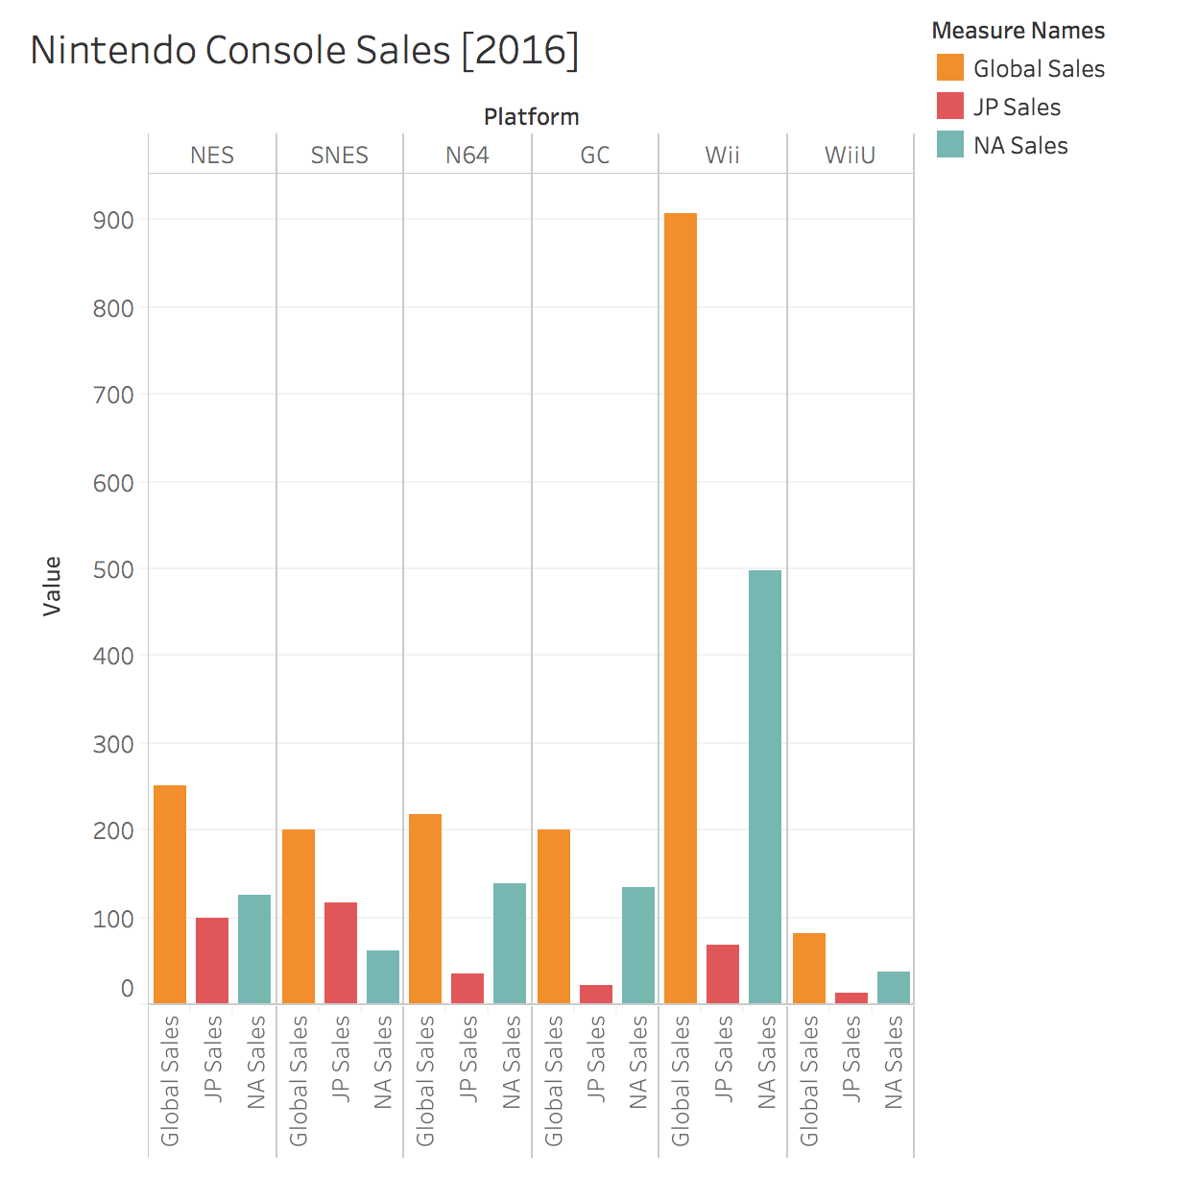
Nintendo: Console Divestment & Consolidation

Slide 11
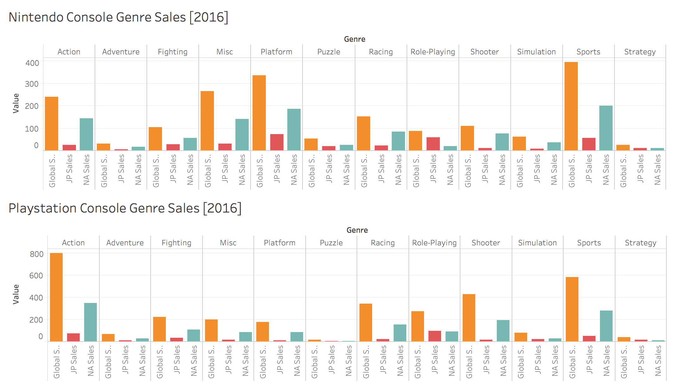
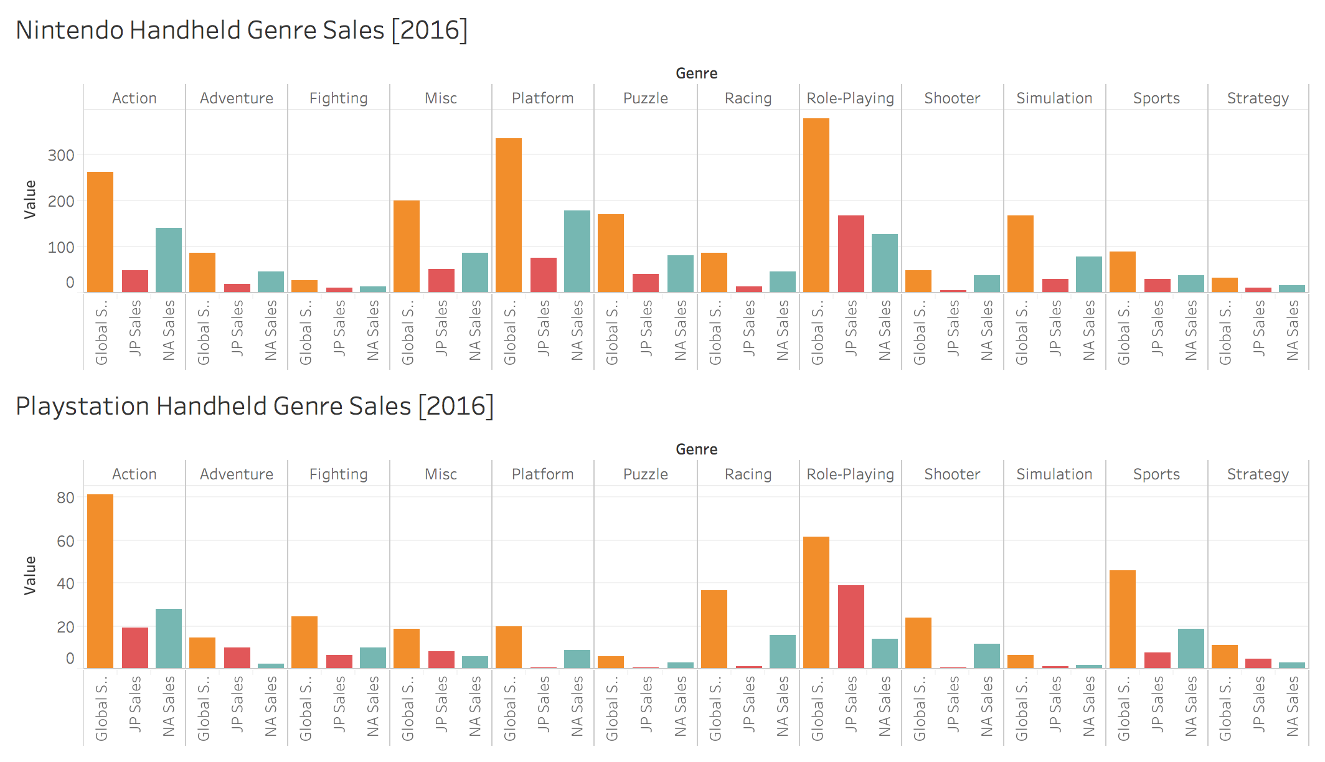
Nintendo: Genre Divestment

Slide 12
Moving Forward
Immediately divest resources from WiiU
01
Invest into development of a new console that takes advantage of Nintendo’s core strengths: portability & intellectual property
02
Provide support for third party developers so that more titles can be enjoyed on Nintendo consoles
03
Consolidate all legacy titles into an electronic format that can be purchased and downloaded online
04
Reallocate resources from Fighting, Shooter, Sports, & Strategy genre games into higher—performing genres
05

